Slide 1
About these claim counts
The claims counts show the total number of claims with COVID-19 or coronavirus exposure given as a nature of injury
All claims submitted are counted, ignoring lost time status and acceptance/denial of benefits
  Primary liability decisions generally arrive a week or two after the claim is reported
The injury report is received a few weeks, on average, after the date of illness
  The illness date is either reported by the worker or employer. It does not always correspond with the date of onset of symptoms.
  DLI continues to receive claims with illness dates from much earlier in the year

Slide 2
5,733 claims reported through October 9

Slide 3
Health care and social assistance is the most common industry sector for COVID-19 claims
*North American Industry Classification System

Slide 4
Hospitals, nursing homes and meat processing plants dominate the CV-19 claims
*North American Industry Classification System

Slide 5
Workers in health care support and professional occupations and production occupations have filed the most claims
*Standard Occupation Classification

Slide 6
Many types of healthcare workers are filing claims
*Standard Occupation Classification

Slide 7
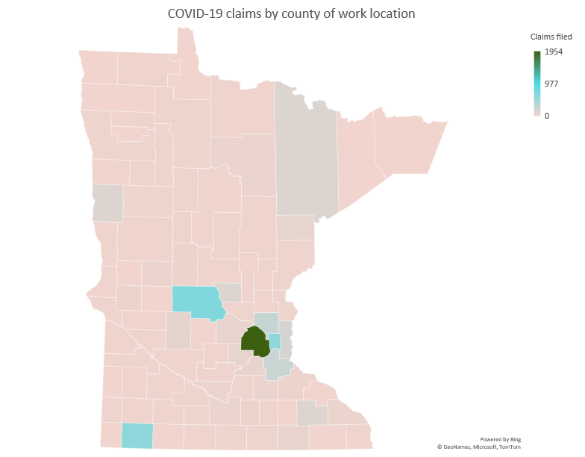
Claims by work location county
5,733 claims received by October 9
12 claims from non-MN work locations
Hover over a county to see the number of claims reported.

